Slide 1
Fuzzy expert systems:
Fuzzy inference
Mamdani fuzzy inference
Sugeno fuzzy inference
Case study
Summary

Slide 2
Fuzzy inference
The most commonly used fuzzy inference technique is the so-called Mamdani method. In 1975, Professor Ebrahim Mamdani of London University built one of the first fuzzy systems to control a steam engine and boiler combination. He applied a set of fuzzy rules supplied by experienced human operators.

Slide 3
Mamdani fuzzy inference
The Mamdani-style fuzzy inference process is performed in four steps:
fuzzification of the input variables,
rule evaluation;
aggregation of the rule outputs, and finally
defuzzification.

Slide 4
We examine a simple two-input one-output problem that includes three rules:
Rule: 1 Rule: 1
IF x is A3 IF project_funding is adequate
OR y is B1 OR project_staffing is small
THEN z is C1 THEN risk is low
Rule: 2 Rule: 2
IF x is A2 IF project_funding is marginal
AND y is B2 AND project_staffing is large
THEN z is C2 THEN risk is normal
Rule: 3 Rule: 3
IF x is A1 IF project_funding is inadequate
THEN z is C3 THEN risk is high

Slide 5
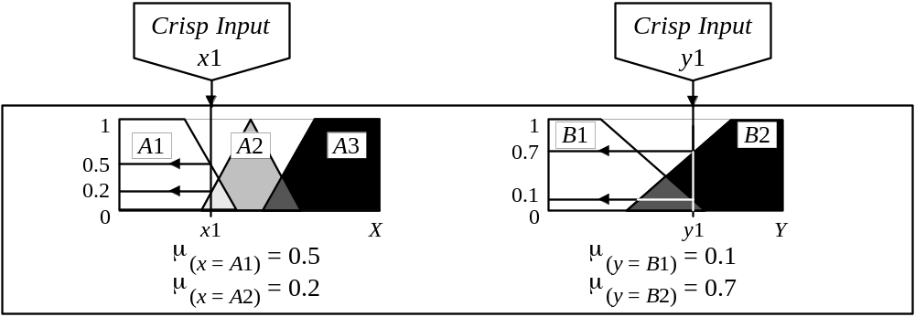
Step 1: Fuzzification
The first step is to take the crisp inputs, x1 and y1 (project funding and project staffing), and determine the degree to which these inputs belong to each of the appropriate fuzzy sets.

Slide 6
Step 2: Rule Evaluation
The second step is to take the fuzzified inputs, μ_{(x=A1)} = 0.5, μ_{(x=A2)} = 0.2, μ_{(y=B1)} = 0.1 and μ_{(y=B2)} = 0.7, and apply them to the antecedents of the fuzzy rules. If a given fuzzy rule has multiple antecedents, the fuzzy operator (AND or OR) is used to obtain a single number that represents the result of the antecedent evaluation. This number (the truth value) is then applied to the consequent membership function.

Slide 7
To evaluate the disjunction of the rule antecedents, we use the OR fuzzy operation. Typically, fuzzy expert systems make use of the classical fuzzy operation union:
    μ_{A}∪_{B}(x) = max [μ_{A}(x), μ_{B}(x)]
Similarly, in order to evaluate the conjunction of the rule antecedents, we apply the AND fuzzy operation intersection:
    μ_{A}∩_{B}(x) = min [μ_{A}(x), μ_{B}(x)]

Slide 8
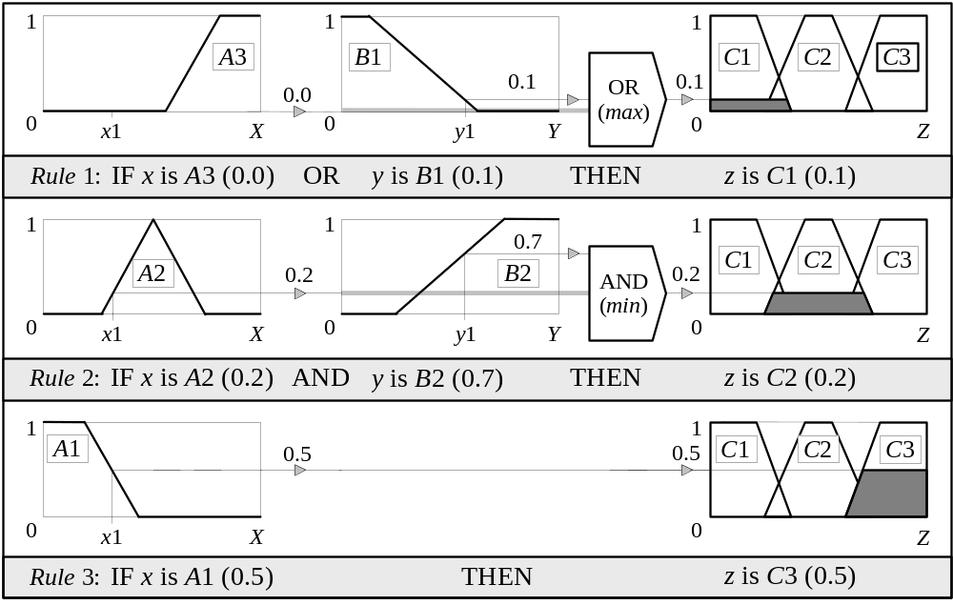
Mamdani-style rule evaluation

Slide 9
Now the result of the antecedent evaluation can be applied to the membership function of the consequent.
The most common method of correlating the rule consequent with the truth value of the rule antecedent is to cut the consequent membership function at the level of the antecedent truth. This method is called clipping. Since the top of the membership function is sliced, the clipped fuzzy set loses some information. However, clipping is still often preferred because it involves less complex and faster mathematics, and generates an aggregated output surface that is easier to defuzzify.

Slide 10
While clipping is a frequently used method, scaling offers a better approach for preserving the original shape of the fuzzy set. The original membership function of the rule consequent is adjusted by multiplying all its membership degrees by the truth value of the rule antecedent. This method, which generally loses less information, can be very useful in fuzzy expert systems.

Slide 11
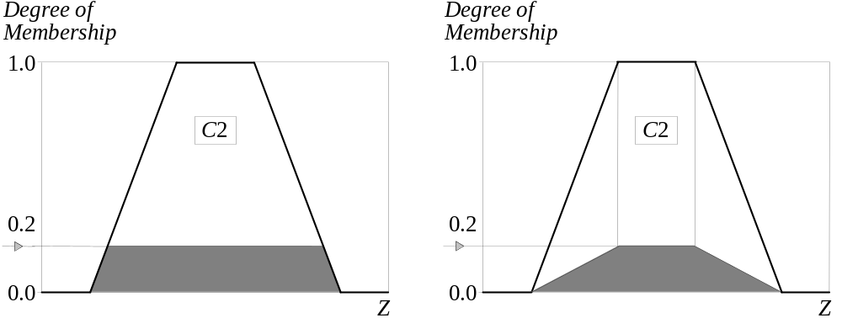
Clipped and scaled membership functions

Slide 12
Step 3: Aggregation of the rule outputs
Aggregation is the process of unification of the outputs of all rules. We take the membership functions of all rule consequents previously clipped or scaled and combine them into a single fuzzy set.
The input of the aggregation process is the list of clipped or scaled consequent membership functions, and the output is one fuzzy set for each output variable.

Slide 13
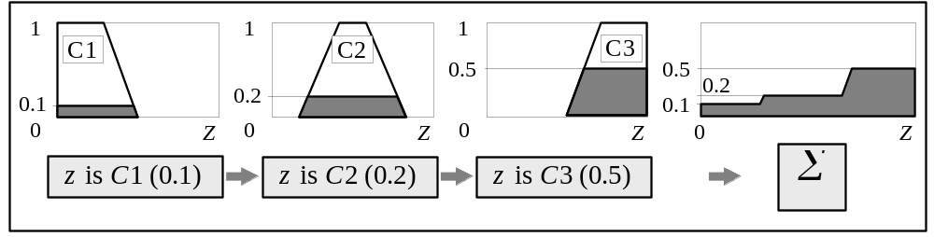
Aggregation of the rule outputs

Slide 14
Step 4: Defuzzification
The last step in the fuzzy inference process is defuzzification. Fuzziness helps us to evaluate the rules, but the final output of a fuzzy system has to be a crisp number. The input for the defuzzification process is the aggregate output fuzzy set and the output is a single number.

Slide 15
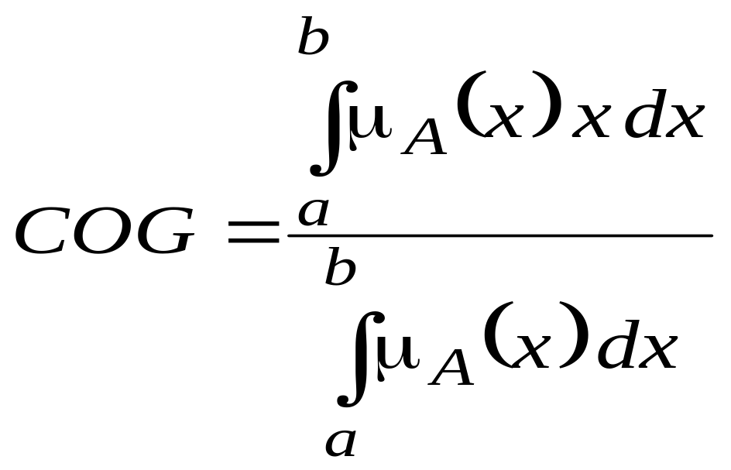
There are several defuzzification methods, but probably the most popular one is the centroid technique. It finds the point where a vertical line would slice the aggregate set into two equal masses. Mathematically this centre of gravity (COG) can be expressed as:

Slide 16
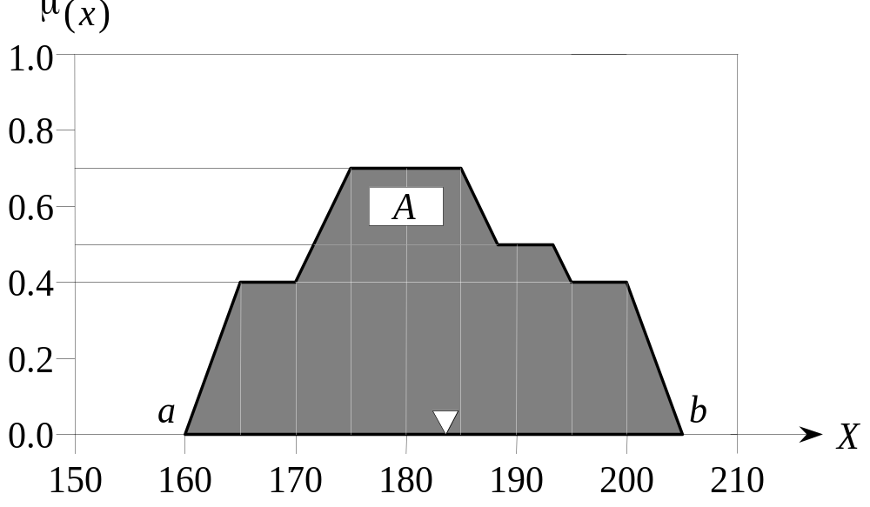
Centroid defuzzification method finds a point representing the centre of gravity of the fuzzy set, A, on the interval, ab.
A reasonable estimate can be obtained by calculating it over a sample of points.

Slide 17
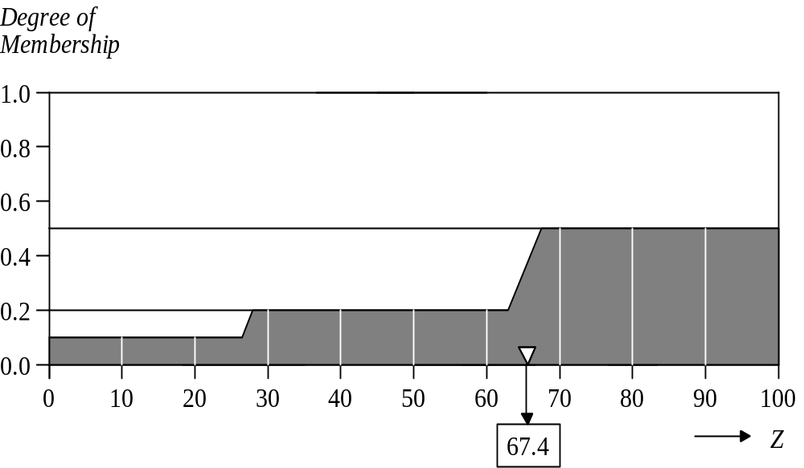
Centre of gravity (COG):

Slide 18
Sugeno fuzzy inference
Mamdani-style inference, as we have just seen, requires us to find the centroid of a two-dimensional shape by integrating across a continuously varying function. In general, this process is not computationally efficient.
Michio Sugeno suggested to use a single spike, a singleton, as the membership function of the rule consequent. A singleton, or more precisely a fuzzy singleton, is a fuzzy set with a membership function that is unity at a single particular point on the universe of discourse and zero everywhere else.

Slide 19
Sugeno-style fuzzy inference is very similar to the Mamdani method. Sugeno changed only a rule consequent. Instead of a fuzzy set, he used a mathematical function of the input variable. The format of the Sugeno-style fuzzy rule is
IF x is A
AND y is B
THEN z is f (x, y)
where x, y and z are linguistic variables; A and B are fuzzy sets on universe of discourses X and Y, respectively; and f (x, y) is a mathematical function.

Slide 20
The most commonly used zero-order Sugeno fuzzy model applies fuzzy rules in the following form:
IF x is A
AND y is B
THEN z is k
where k is a constant.
In this case, the output of each fuzzy rule is constant. All consequent membership functions are represented by singleton spikes.

Slide 21
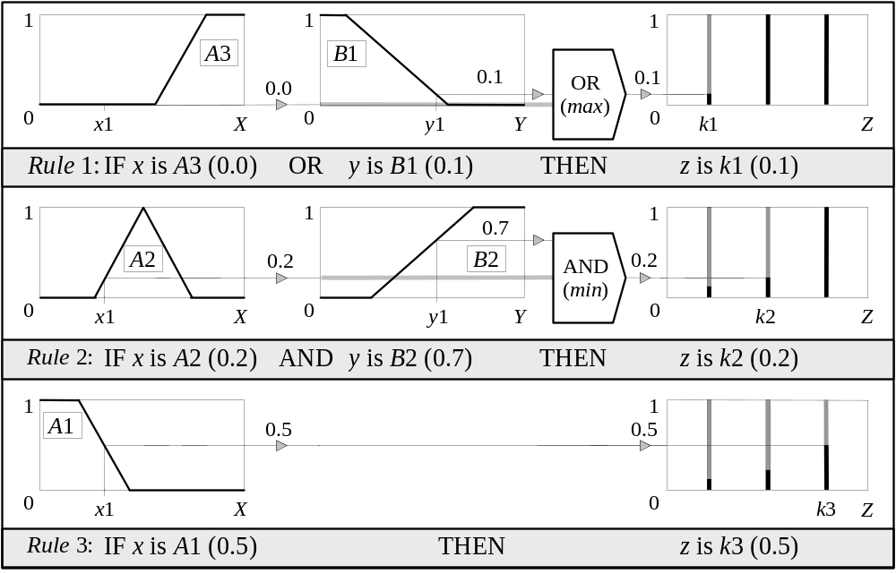
Sugeno-style rule evaluation

Slide 22
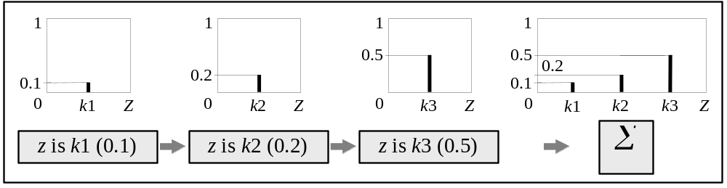
Sugeno-style aggregation of the rule outputs

Slide 23
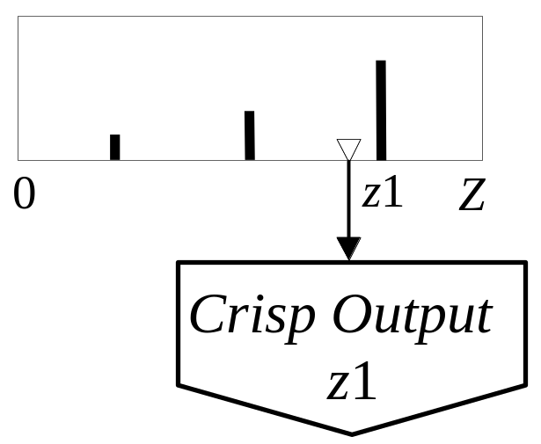
Weighted average (WA):
Sugeno-style defuzzification

Slide 24
How to make a decision on which method to apply − Mamdani or Sugeno?
Mamdani method is widely accepted for capturing expert knowledge. It allows us to describe the expertise in more intuitive, more human-like manner. However, Mamdani-type fuzzy inference entails a substantial computational burden.
On the other hand, Sugeno method is computationally effective and works well with optimisation and adaptive techniques, which makes it very attractive in control problems, particularly for dynamic nonlinear systems.

Slide 25
Building a fuzzy expert system: case study
A service centre keeps spare parts and repairs failed ones.
A customer brings a failed item and receives a spare of the same type.
Failed parts are repaired, placed on the shelf, and thus become spares.
The objective here is to advise a manager of the service centre on certain decision policies to keep the customers satisfied.

Slide 26
Process of developing a fuzzy expert system
1. Specify the problem and define linguistic variables.
2. Determine fuzzy sets.
3. Elicit and construct fuzzy rules.
4. Encode the fuzzy sets, fuzzy rules and procedures
to perform fuzzy inference into the expert system.
5. Evaluate and tune the system.

Slide 27
Step 1: Specify the problem and define
linguistic variables
There are four main linguistic variables: average waiting time (mean delay) m, repair utilisation factor of the service centre ρ, number of servers s, and initial number of spare parts n.

Slide 28
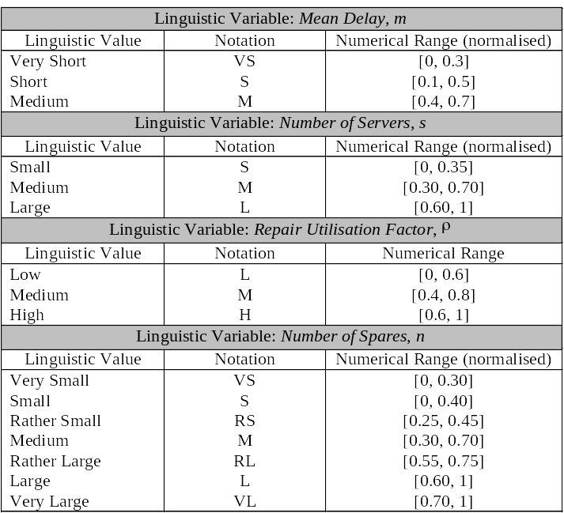
Linguistic variables and their ranges

Slide 29
Step 2: Determine fuzzy sets
Fuzzy sets can have a variety of shapes. However, a triangle or a trapezoid can often provide an adequate representation of the expert knowledge, and at the same time, significantly simplifies the process of computation.

Slide 30
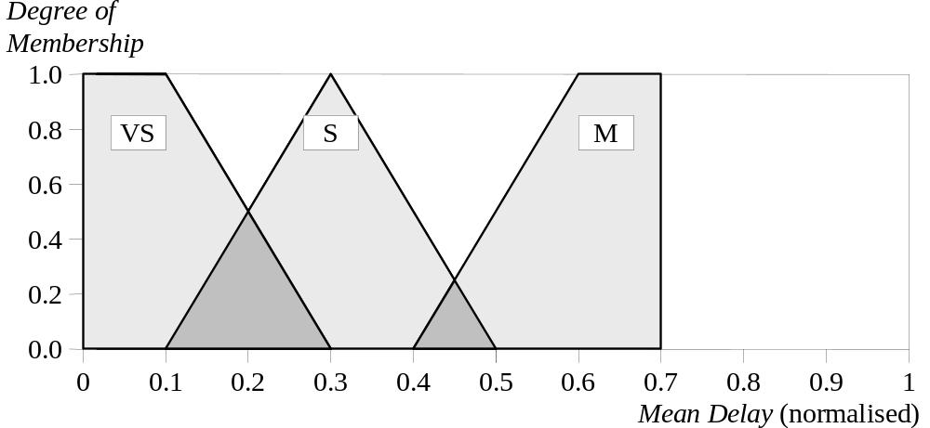
Fuzzy sets of Mean Delay m

Slide 31
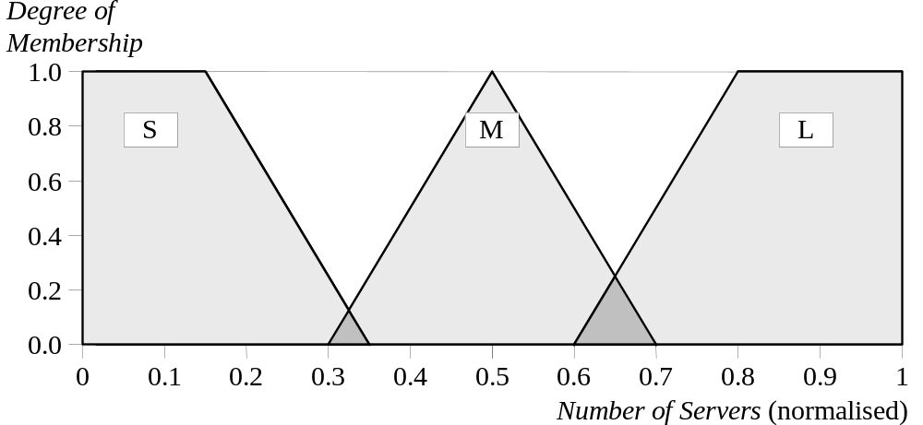
Fuzzy sets of Number of Servers s

Slide 32
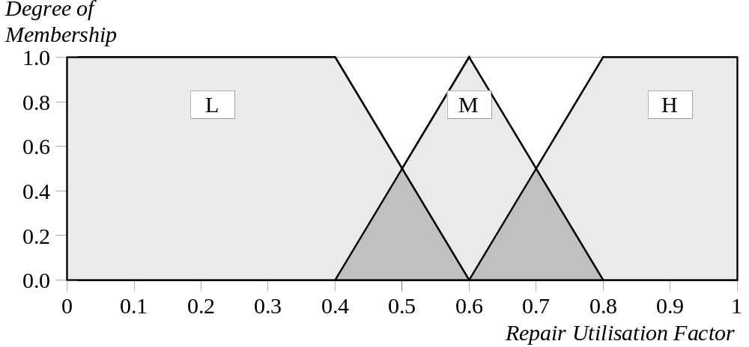
Fuzzy sets of Repair Utilisation Factor ρ

Slide 33
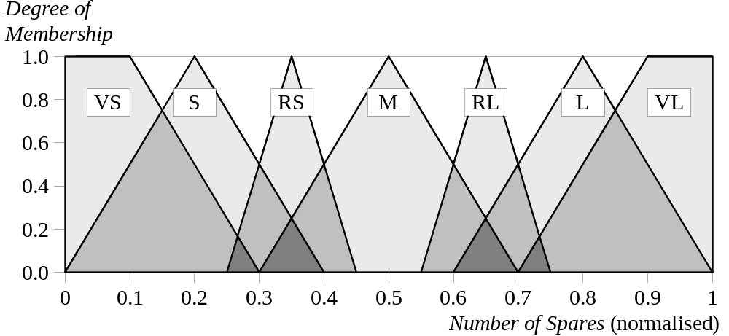
Fuzzy sets of Number of Spares n

Slide 34
Step 3: Elicit and construct fuzzy rules
To accomplish this task, we might ask the expert to describe how the problem can be solved using the fuzzy linguistic variables defined previously.
Required knowledge also can be collected from other sources such as books, computer databases, flow diagrams and observed human behaviour.

Slide 35
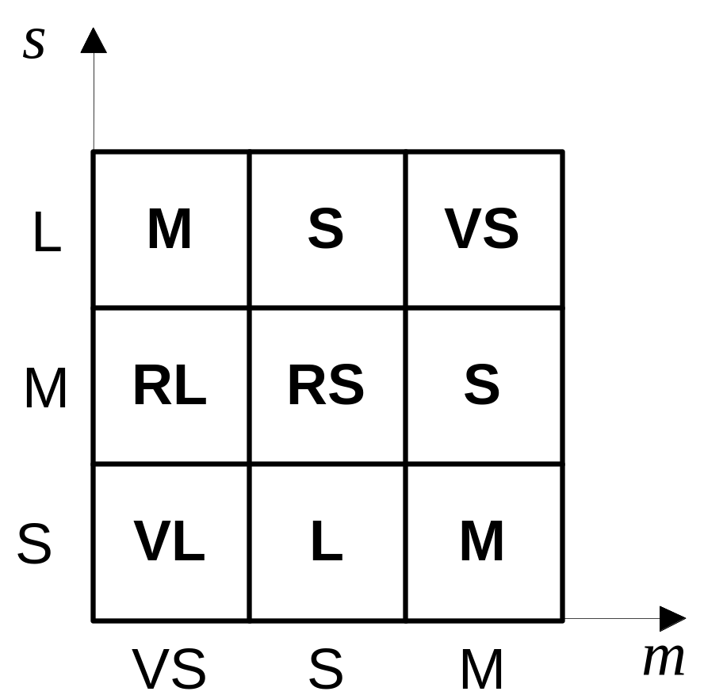
The square FAM representation

Slide 36
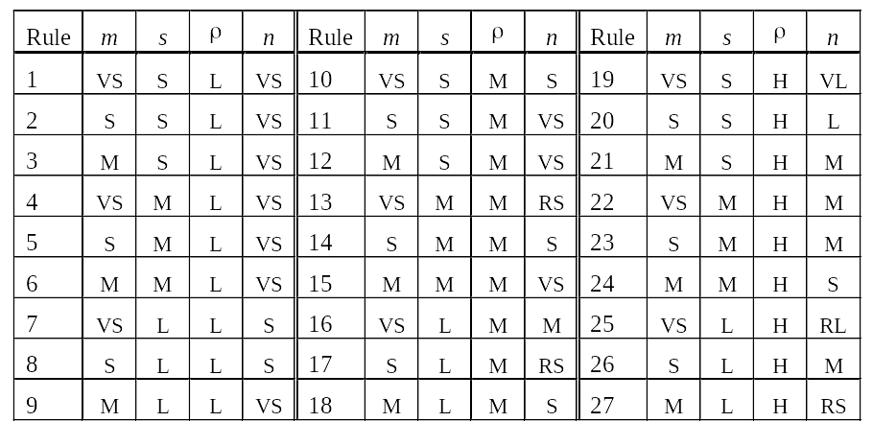
The rule table

Slide 37
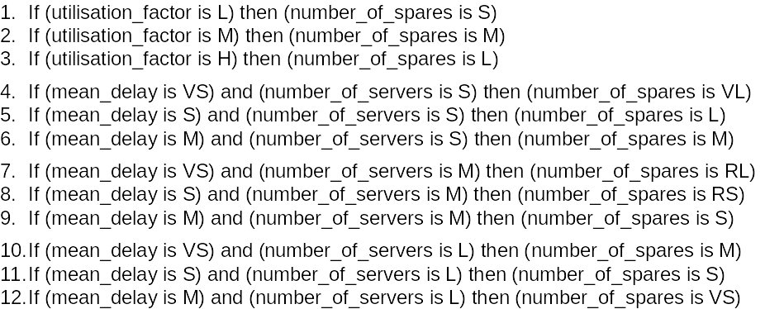
Rule Base 1

Slide 38
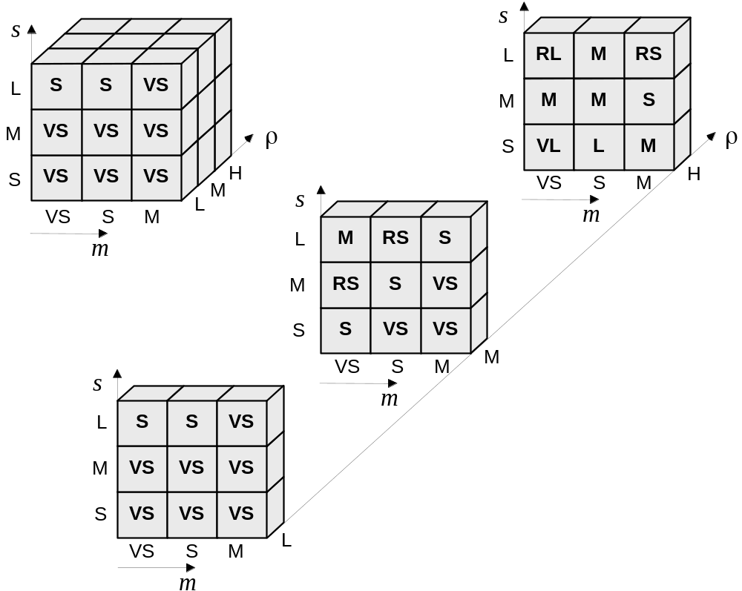
Cube FAM of Rule Base 2

Slide 39
Step 4: Encode the fuzzy sets, fuzzy rules
and procedures to perform fuzzy
inference into the expert system
To accomplish this task, we may choose one of two options: to build our system using a programming language such as C/C++ or Pascal, or to apply a fuzzy logic development tool such as MATLAB Fuzzy Logic Toolbox or Fuzzy Knowledge Builder.

Slide 40
Step 5: Evaluate and tune the system
The last, and the most laborious, task is to evaluate and tune the system. We want to see whether our fuzzy system meets the requirements specified at the beginning.
Several test situations depend on the mean delay, number of servers and repair utilisation factor.
The Fuzzy Logic Toolbox can generate surface to help us analyse the system’s performance.

Slide 41
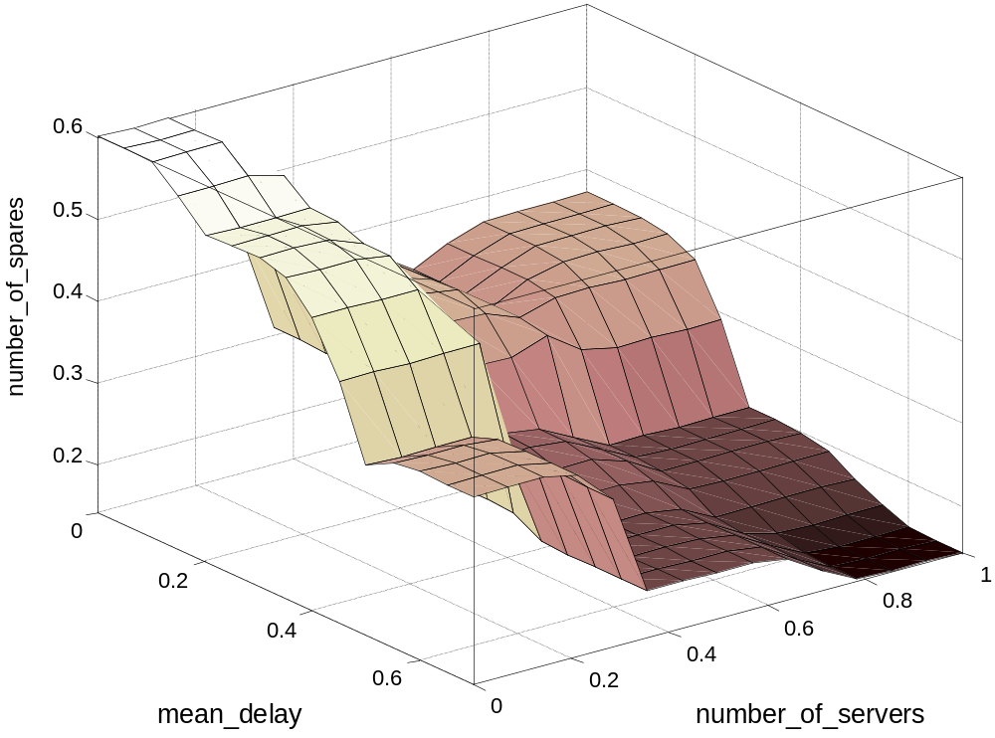
Three-dimensional plots for Rule Base 1

Slide 42
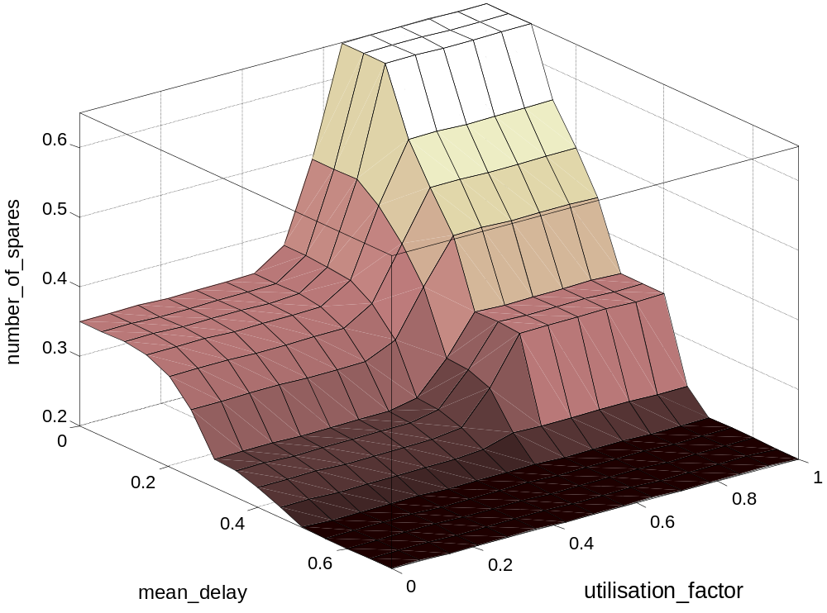
Three-dimensional plots for Rule Base 1

Slide 43
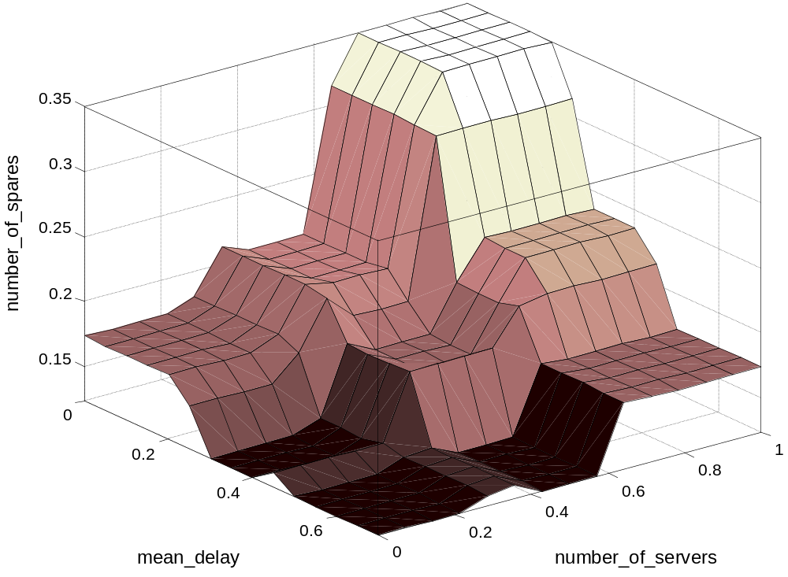
Three-dimensional plots for Rule Base 2

Slide 44
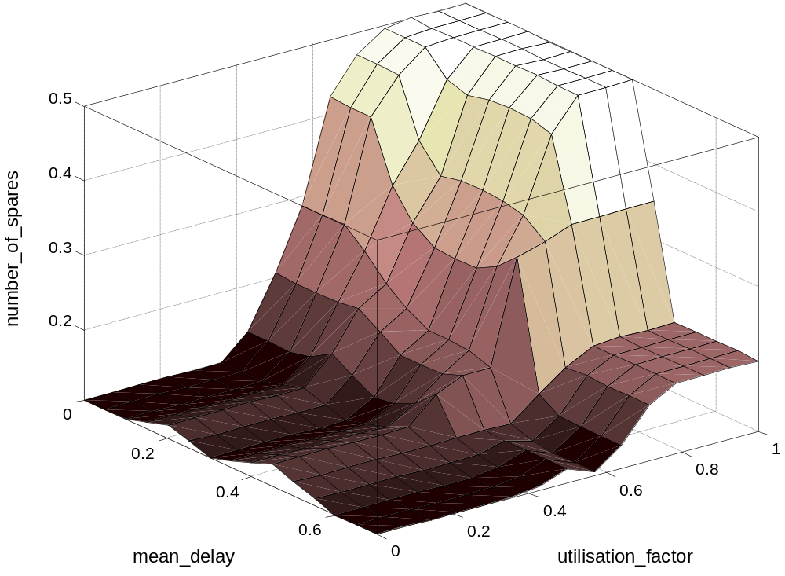
Three-dimensional plots for Rule Base 2

Slide 45
However, even now, the expert might not be satisfied with the system performance.
To improve the system performance, we may use additional sets − Rather Small and Rather Large − on the universe of discourse Number of Servers, and then extend the rule base.

Slide 46
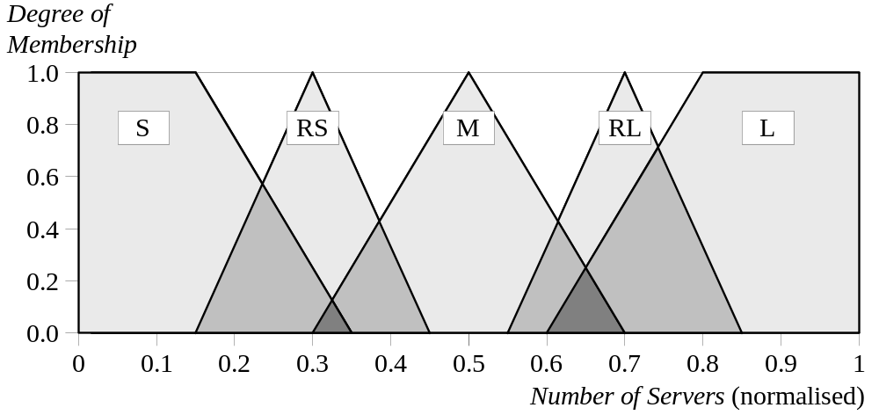
Modified fuzzy sets of Number of Servers s

Slide 47
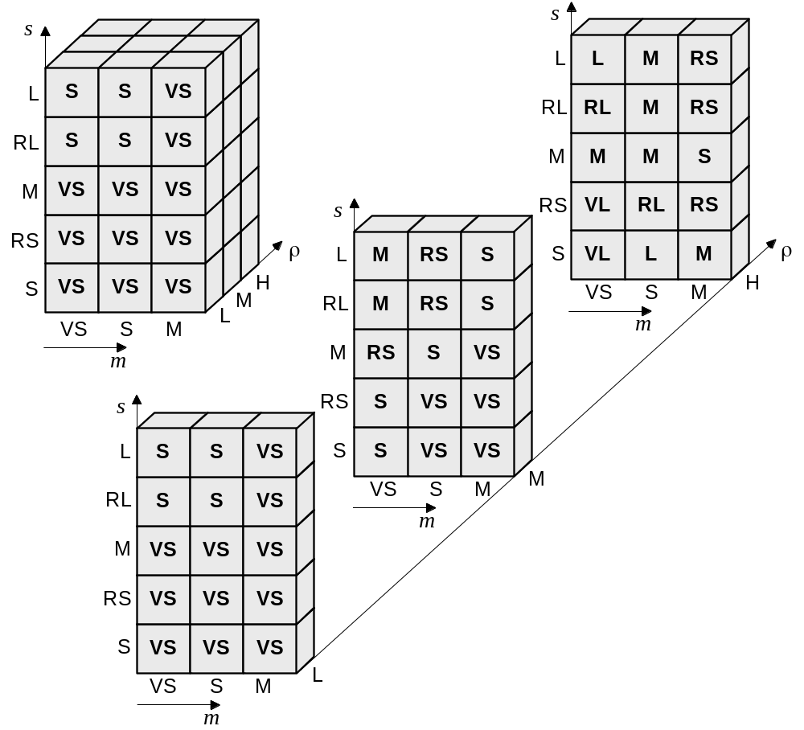
Cube FAM of Rule Base 3

Slide 48
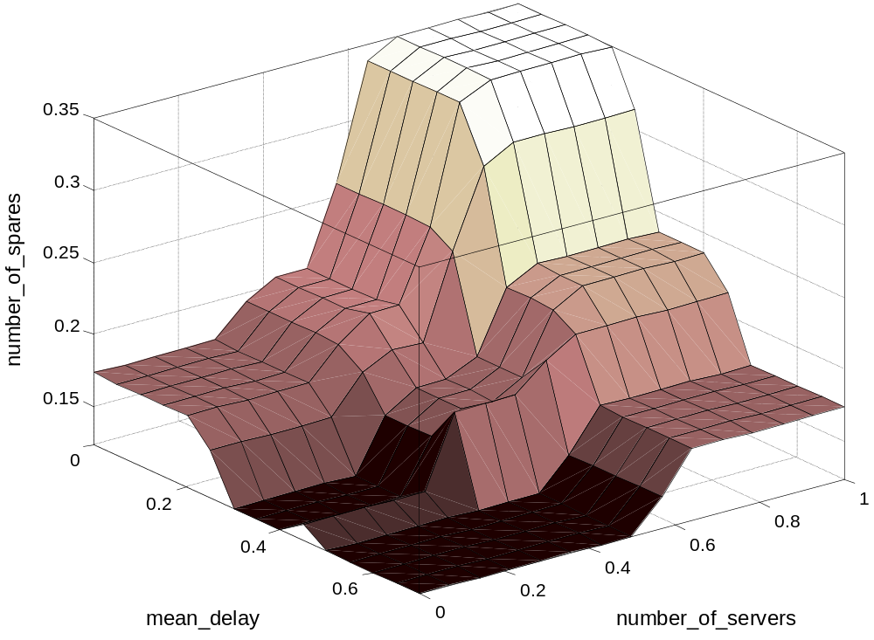
Three-dimensional plots for Rule Base 3

Slide 49
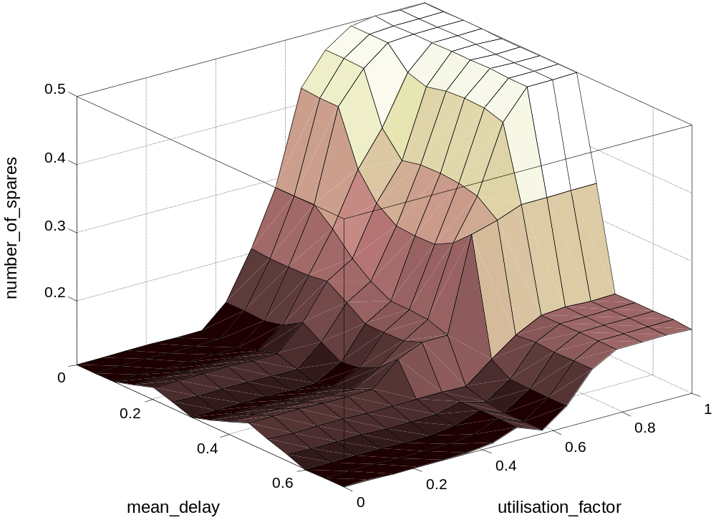
Three-dimensional plots for Rule Base 3

Slide 50
Tuning fuzzy systems
1. Review model input and output variables, and if
required redefine their ranges.
2. Review the fuzzy sets, and if required define
additional sets on the universe of discourse.
The use of wide fuzzy sets may cause the fuzzy
system to perform roughly.
3. Provide sufficient overlap between neighbouring
sets. It is suggested that triangle-to-triangle and
trapezoid-to-triangle fuzzy sets should overlap
between 25% to 50% of their bases.

Slide 51
4. Review the existing rules, and if required add new
rules to the rule base.
5. Examine the rule base for opportunities to write
hedge rules to capture the pathological behaviour
of the system.
6. Adjust the rule execution weights. Most fuzzy
logic tools allow control of the importance of rules
by changing a weight multiplier.
7. Revise shapes of the fuzzy sets. In most cases,
fuzzy systems are highly tolerant of a shape
approximation.

